Slide 1

Data Lake Value Proposition
Medical Data Processing Company
CAO HOAI PHUONG
Udacity IPS Version 1.0

Slide 2
Agenda
What is a Data Lake
Components of a Data Lake
Data Lake vs Data Warehouse
Business Value of Data Lake Solution
Proposed Data Lake Architecture for Medical Data Processing system
Udacity IPS Ver. 1 2/2020

Slide 3
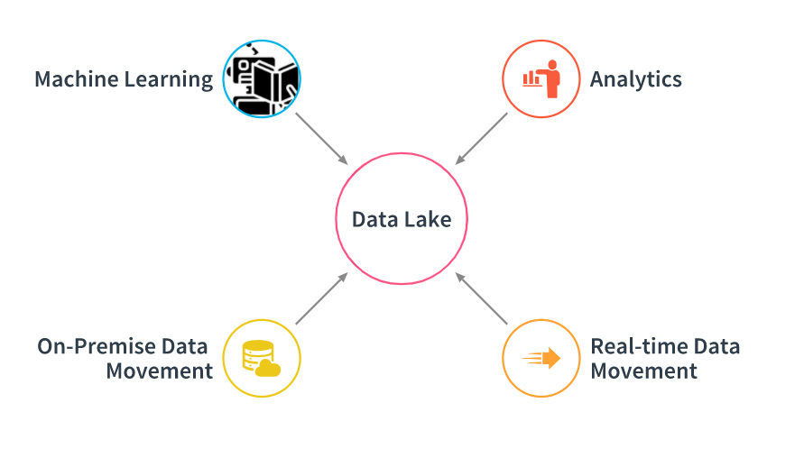
What is a Data Lake
10,000 foot view
Notes:
At 10,000 foot view the high-level framework for building a data lake that show how analytics systems work with source and destination systems

Slide 4

What is a Data Lake
5000 foot view

Slide 5
Components of Data Lake
Storage Layer
Ingestion Layer
Processing and Analytics Layer:
Serving Layer
About Data Catalog, Governance and Security

Slide 6
Data Lake vs Data Warehouse
Data lakes and data warehouses are similar in that they both store and process data, each have their own specialties, and therefore their own use cases. That's why it's common for an enterprise-level organization to include a data lake and a data warehouse in their analytics ecosystem. what's the difference between a data lake and a data warehouse? And when is it appropriate to use one over the other?

Slide 7
Data Warehouse
Data Lake
A
B
C
…
...
A
B
C
…
...
Udacity IPS Ver. 1 2/2020

Slide 8
Business Value of Data Lake
< Think about: Provide an executive level summary based on your analysis of problem statement. How would implementing a Data Lake solution help Medical Data Processing Company? Please identify at least 3 business outcomes of building a Data Lake?>
<Video tip: Explain “Why” Data Lake solution makes sense for Medical Data Processing Company. >
A
B
C
…
...

Slide 9
Data Lake Architecture
< Embed your Architecture Diagram of Data Lake you created in Step 2. >
< Video tip: You can also use additional slides to briefly elaborate or highlight any area from your architecture. You can also choose where to include this slide.

Slide 10
THANK YOU
Udacity IPS Version 1.0

